Slide 1


Slide 2

Data Analysis
An Extensive Dataset with 4,30,000 Entries is taken for Analysis (Satellite Data).
Individual Pollutant Indices are calculated using standard Procedures in different functions.
Data is analysed on Yearly, Monthly and Weekly Basis covering comparisons between :
AQI is calculated by taking Maximum among all major Pollutant Indices (SO2, NO2, SPM (Suspended Particulate Matter), Respirable SPM).
States/UTs vs AQI/Pollutants vs Year

Slide 3


Slide 4
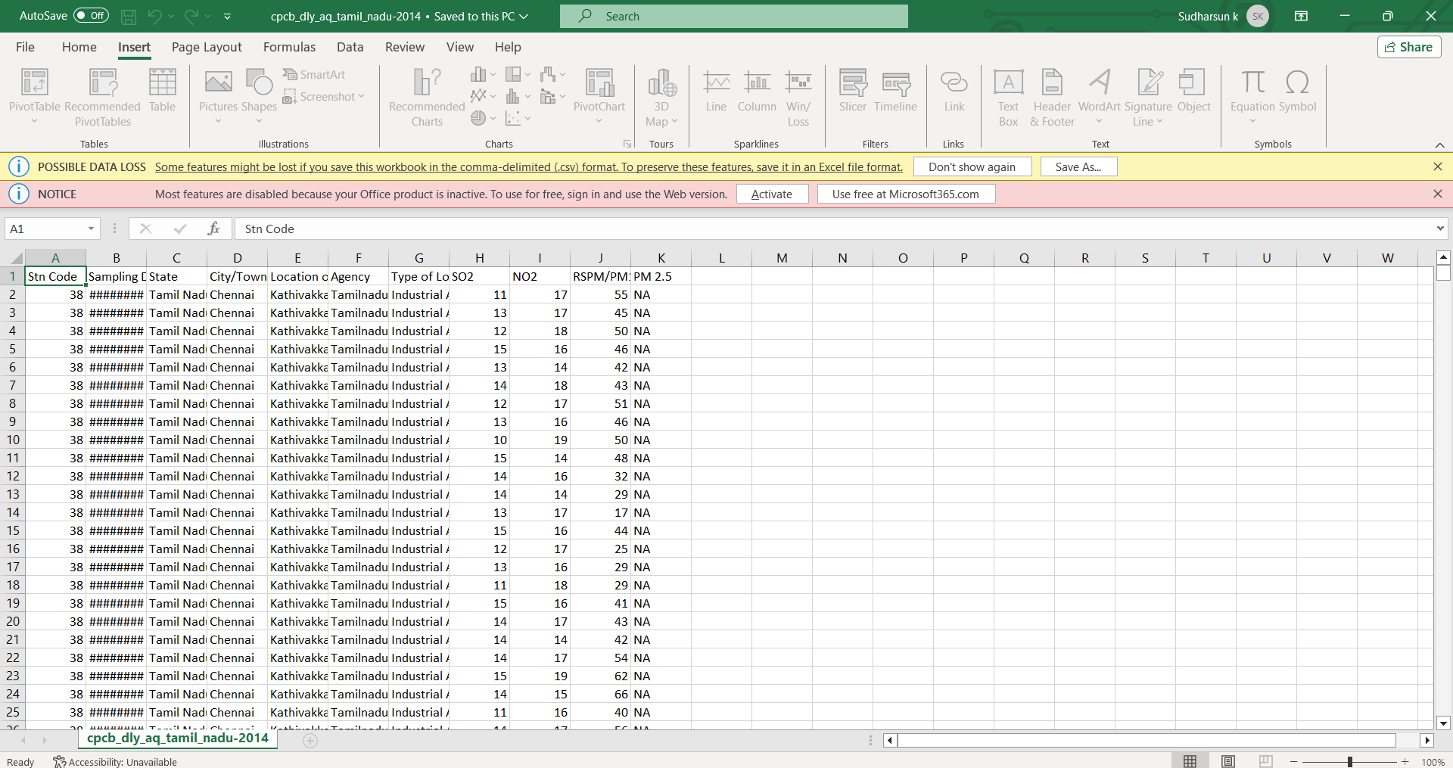

Slide 5
